Slide 1
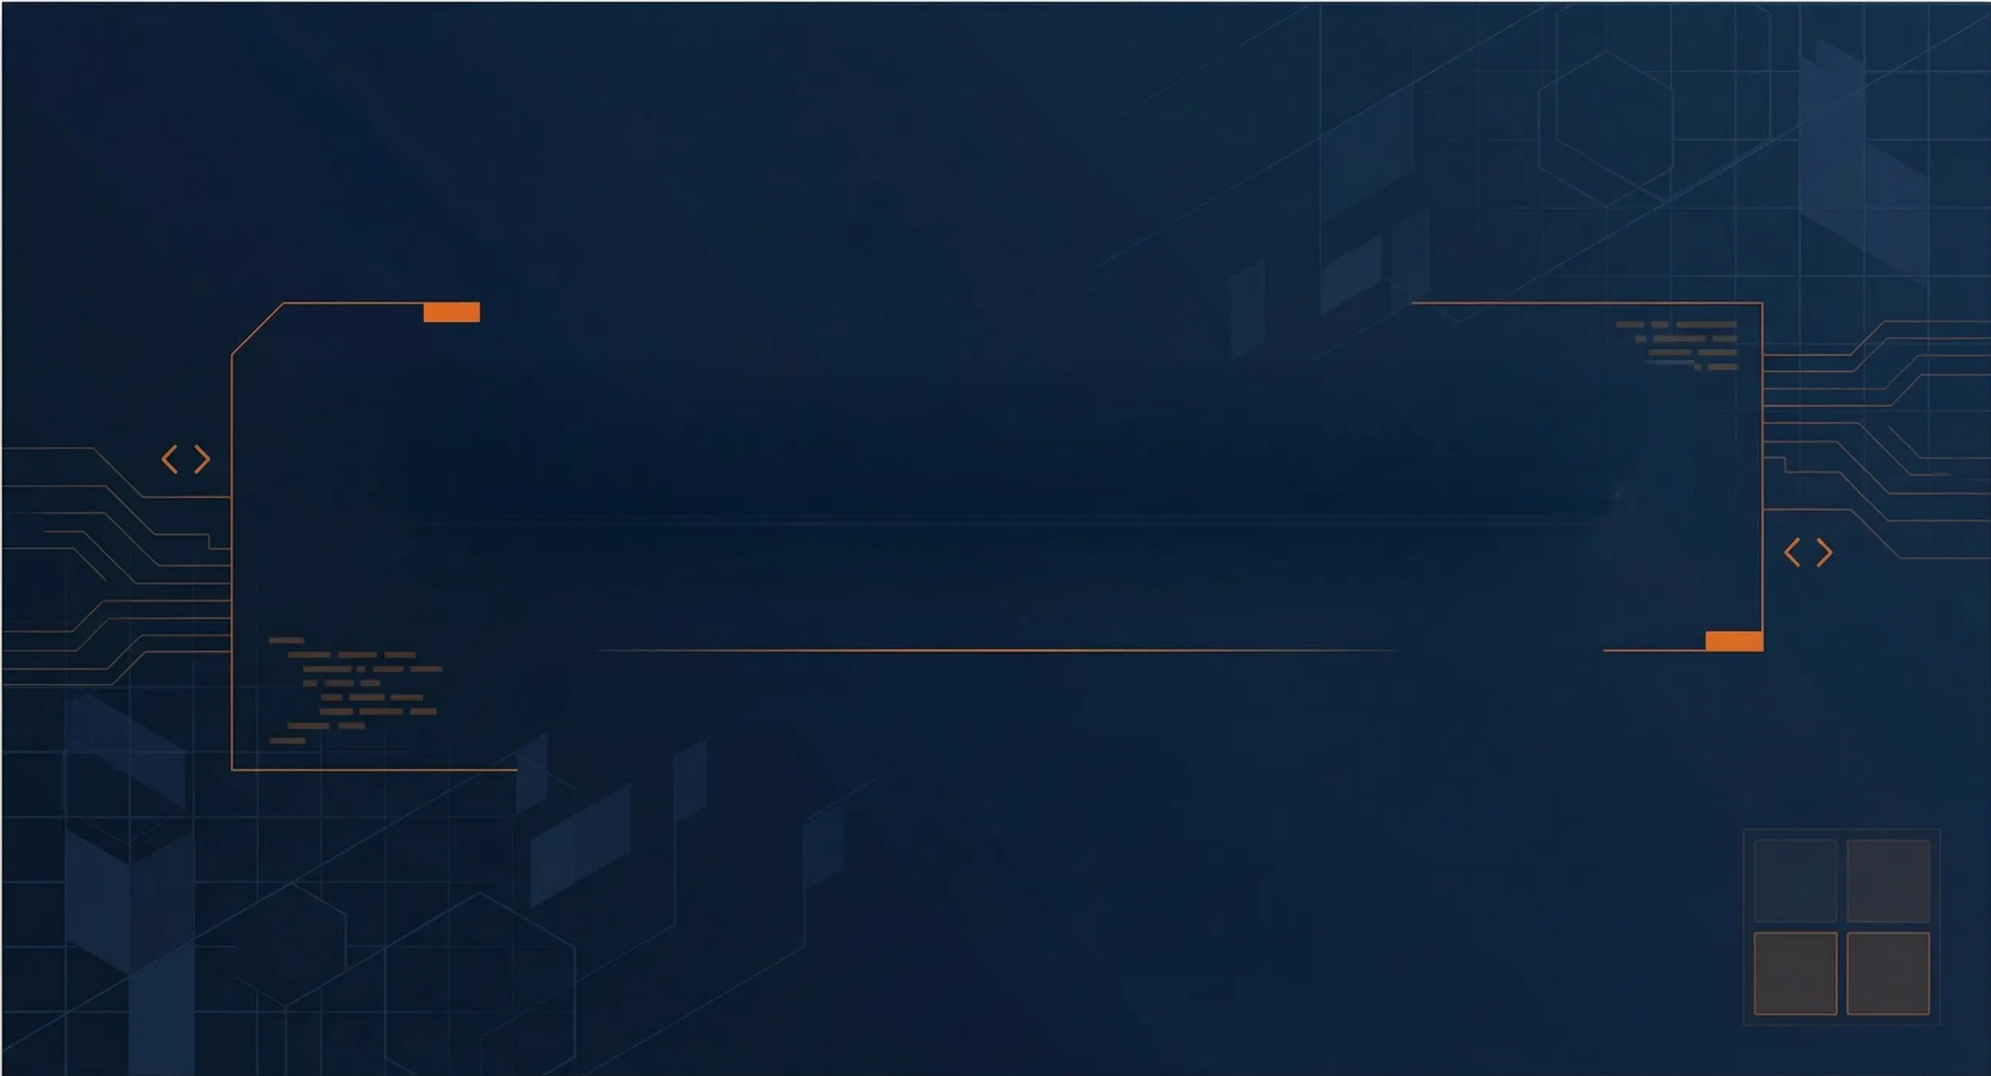
2048 Game Project
C + SDL2 Implementation
Technical Documentation & Implementation Guide
Members
1.Sriyash Ghodke 2.Shiv Mudgal 3.Priyanka Gupta
4.Rayyan Ansari 5.Shravya Bhatt
2
4
8
16

Slide 2
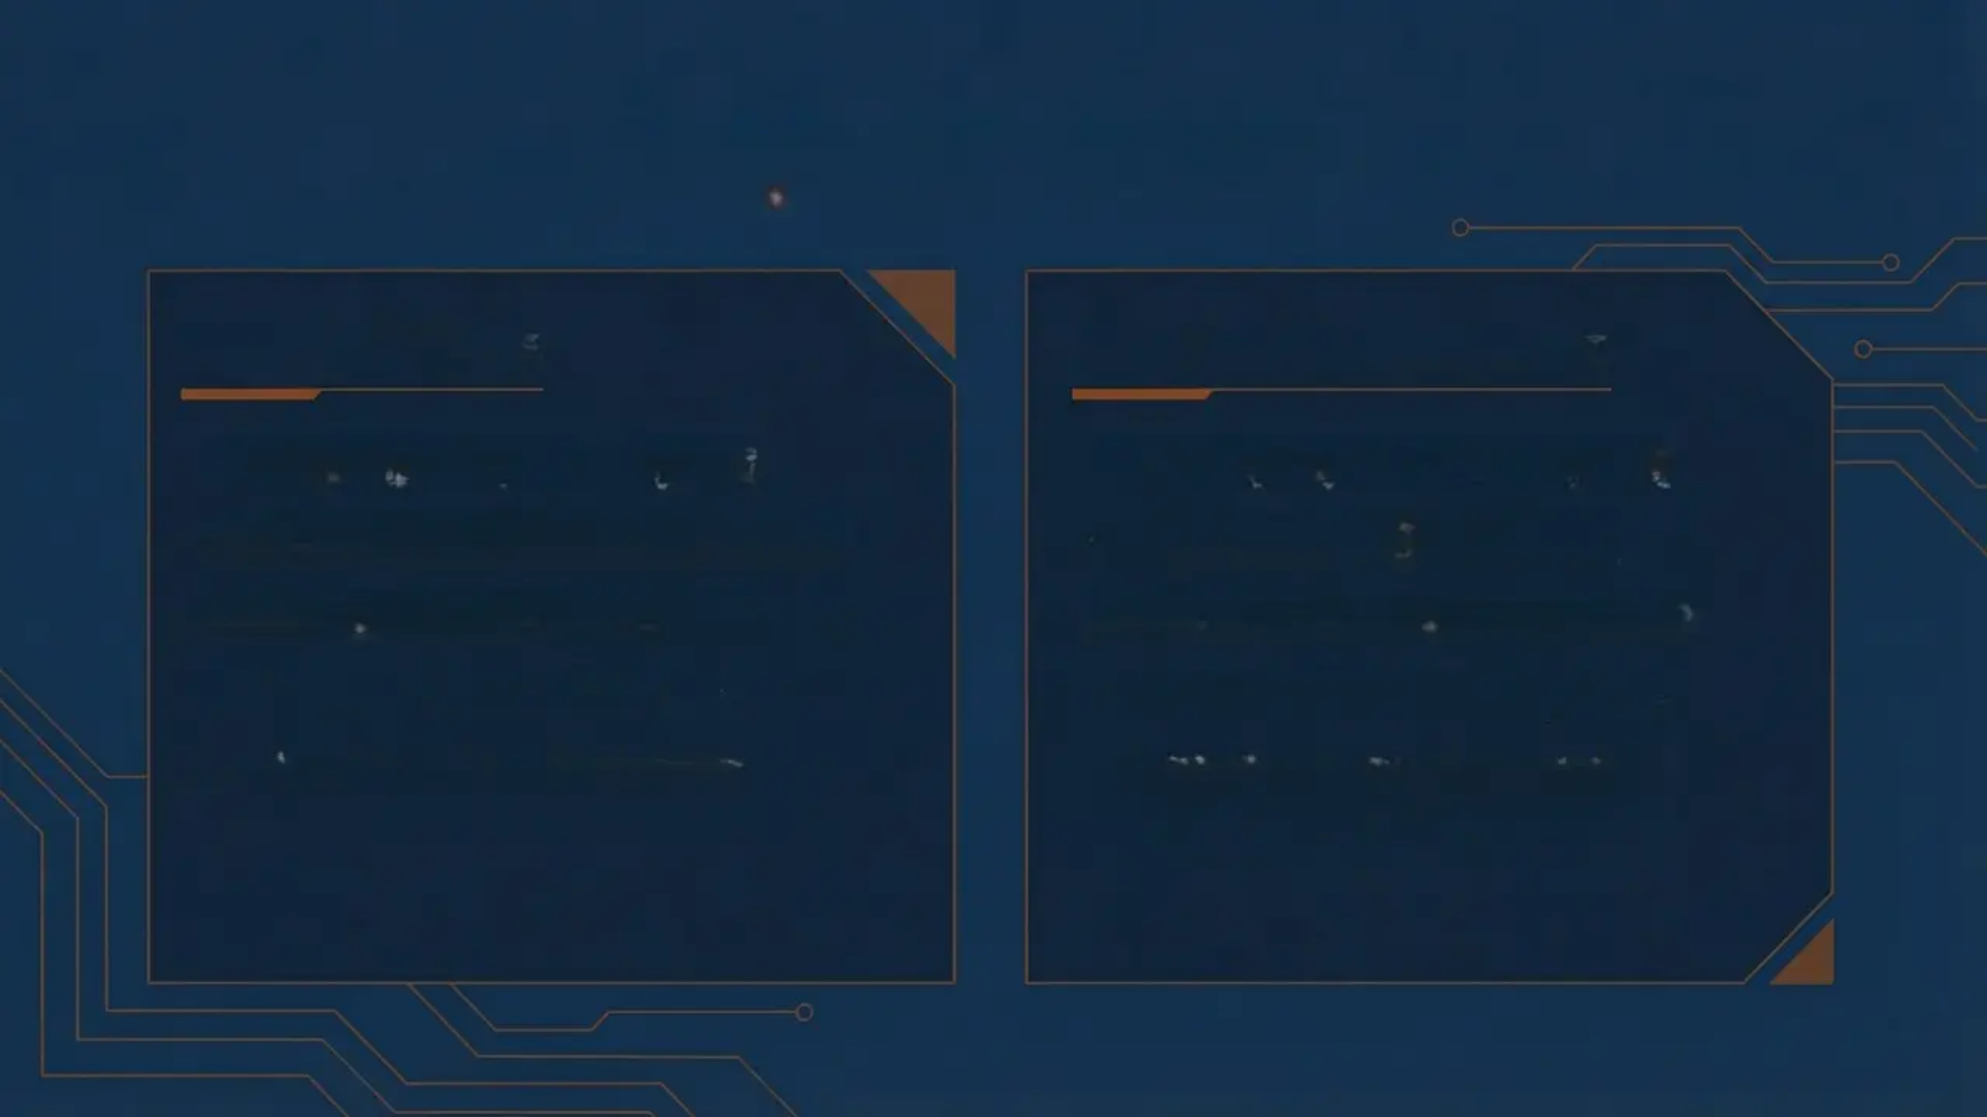
Project Overview
Game Rules
Technology Stack
Sliding tile puzzle game
Language: ANSI C (C99)
4×4 grid with numbered tiles
Graphics: SDL2 library
Merge identical adjacent tiles
Fonts: SDL2_ttf extension
Goal: Create 2048 tile
Window: 900×800 pixels
Game over when stuck
Platform: Windows/Linux compatible

Slide 3
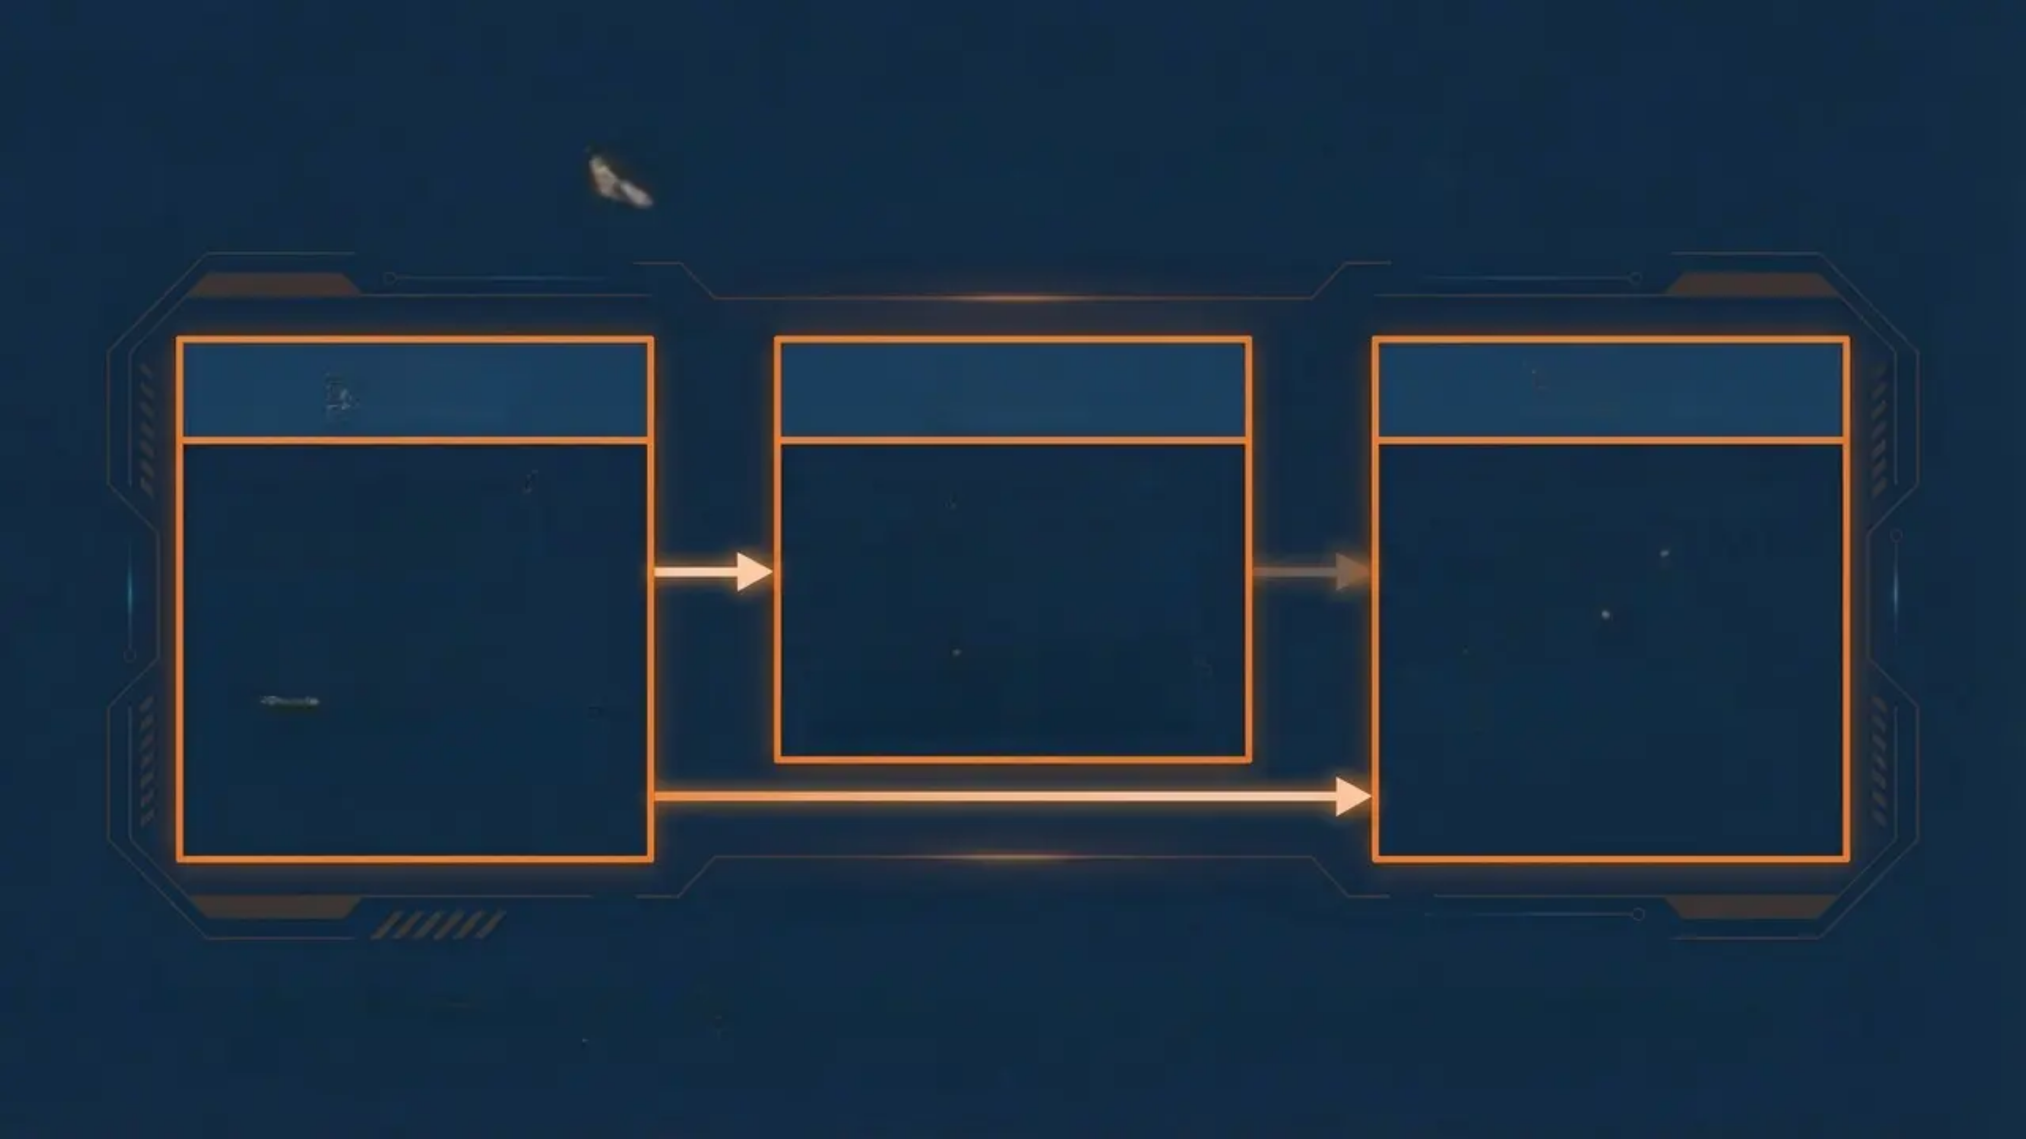
System Architecture
game.h
game.c
main.c
• Public interface header • Function declarations • No implementation code
• Core game logic • SDL2-independent operations • Board manipulation & scoring
• SDL2 entry point • Event loop & rendering • UI presentation layer
Clean separation: game logic can be unit-tested or ported without SDL2 modification

Slide 4
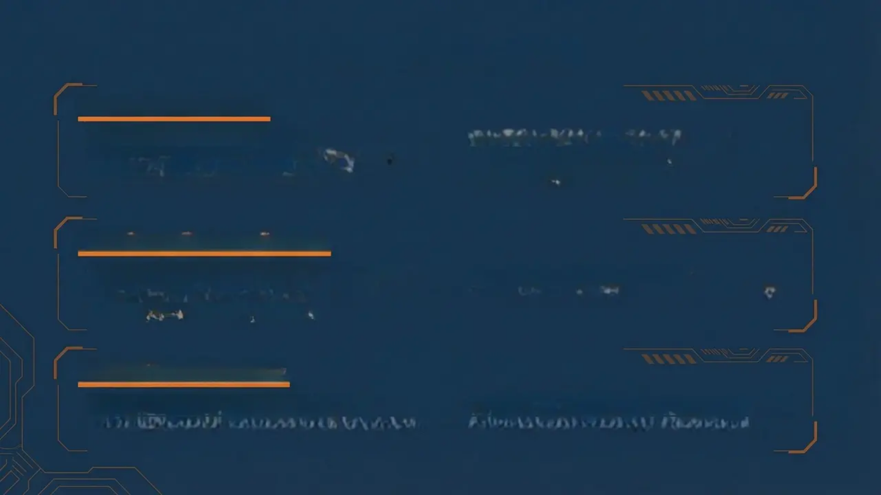
Data Structures
Core Game Board
• int board[4][4] - main array • Stack-allocated, cache-friendly design • board[row][col] indexing system
• int board[4][4] - main sioduation • barv[row][co] indexing system • 0 = empty, powers of 2
Auxiliary Arrays (Local)
• original[4] - change detection snapshot • temp[4] - compaction working area • final[4] - post-merge result
• empt[4] - post-merge result • empty_tiles[16][2] - coordinate storage
SDL2 Library Types
• SDL_Window* - 900x800 window • SDL_Renderer* - hardware acceleration
• SDL_Rect - positioning rectangles • TTF_Font* - TrueType font handle

Slide 5
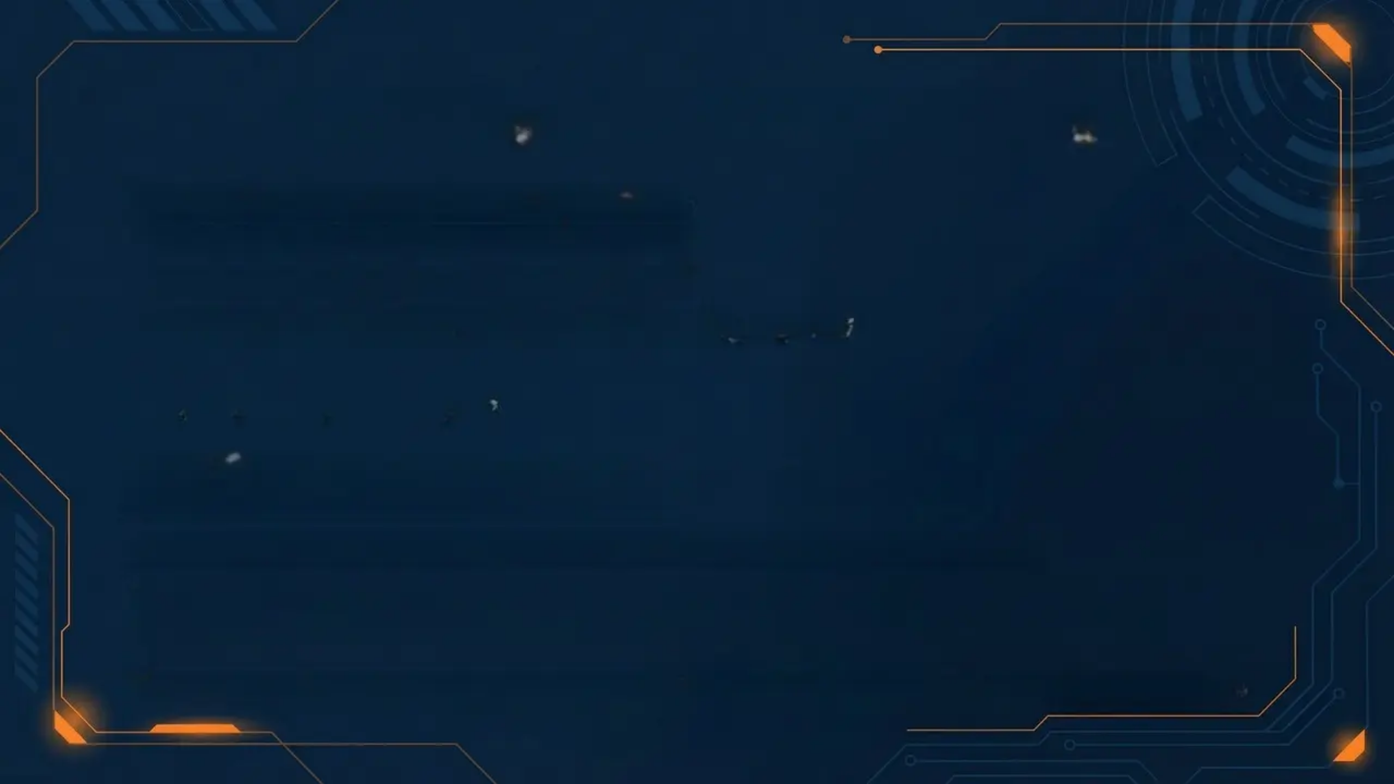
Core Algorithm: Tile Sliding
Three-Phase Movement Algorithm:
• Phase 1: Compact (remove zeros) • Phase 2: Merge (combine equals) • Phase 3: Re-compact (remove merge gaps)
Step-by-Step Example:
Initial: [0, 2, 2, 4] Phase 1 (compact): [2, 2, 4, 0] // zero removed Phase 2 (merge): [4, 0, 4, 0] // 2+2=4, temp[1] zeroed Phase 3 (final): [4, 4, 0, 0] // zero from merge removed

Slide 6
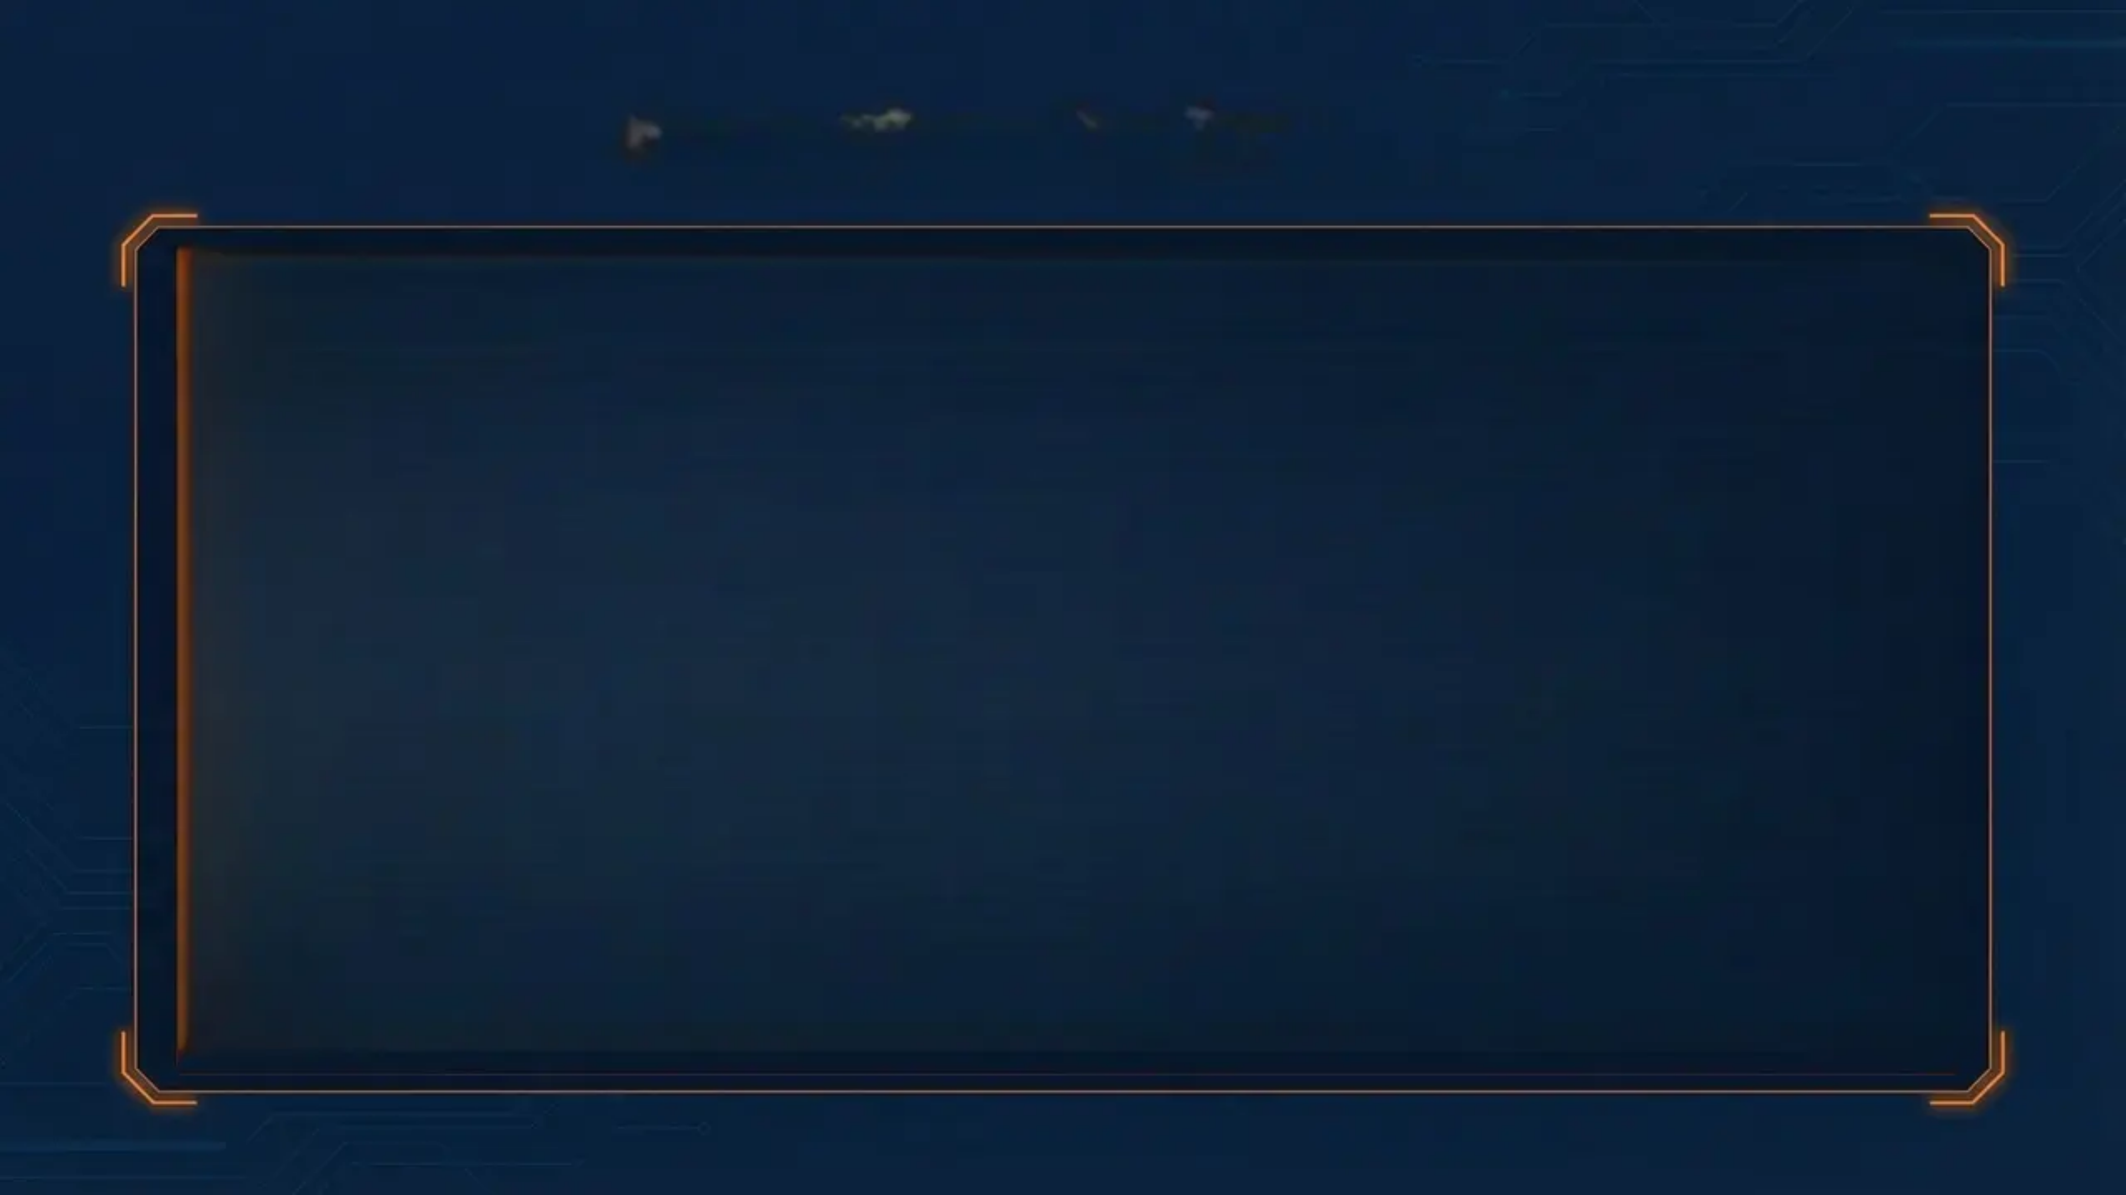
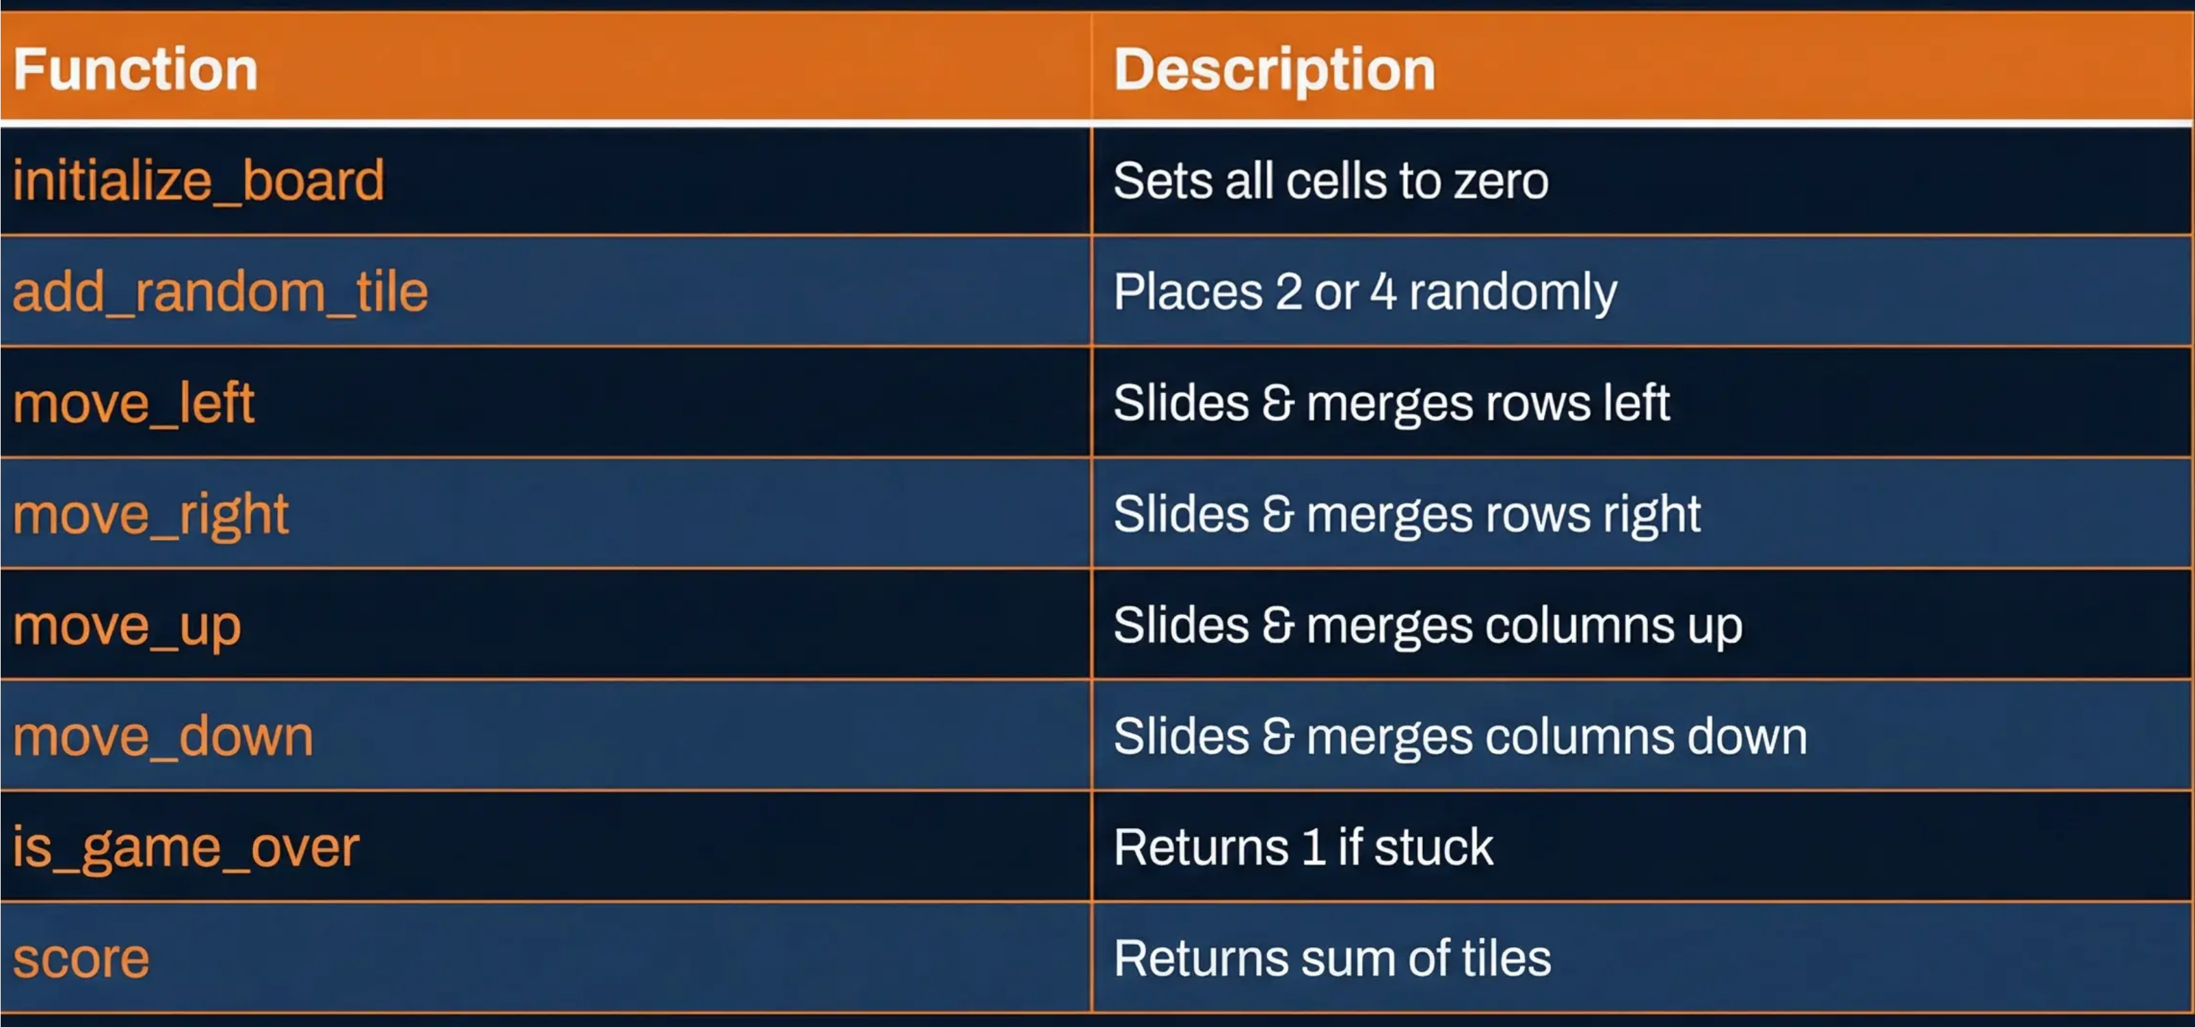
Function Reference

Slide 7
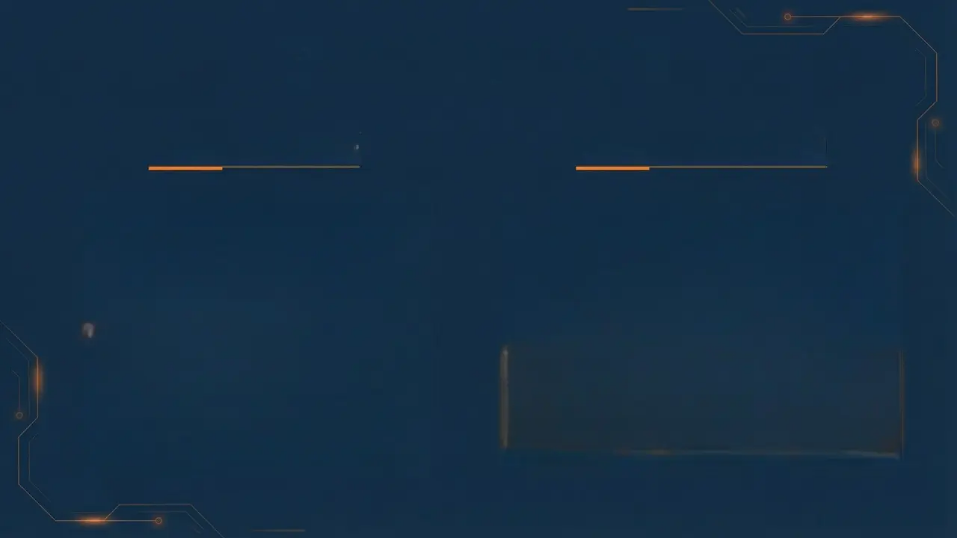
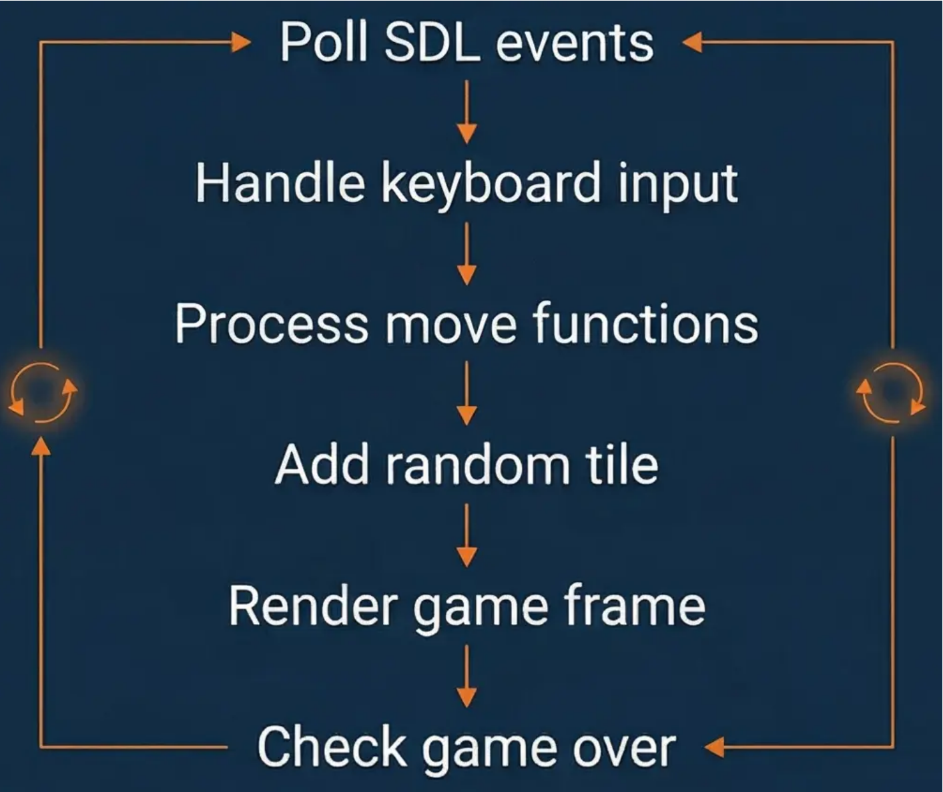
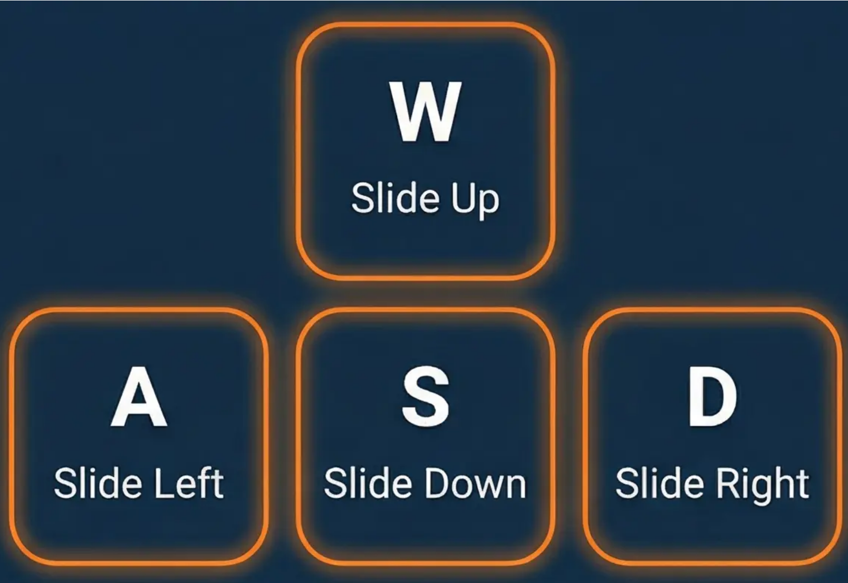
Game Loop & Input
Main Event Loop
WASD Key Mapping

Slide 8
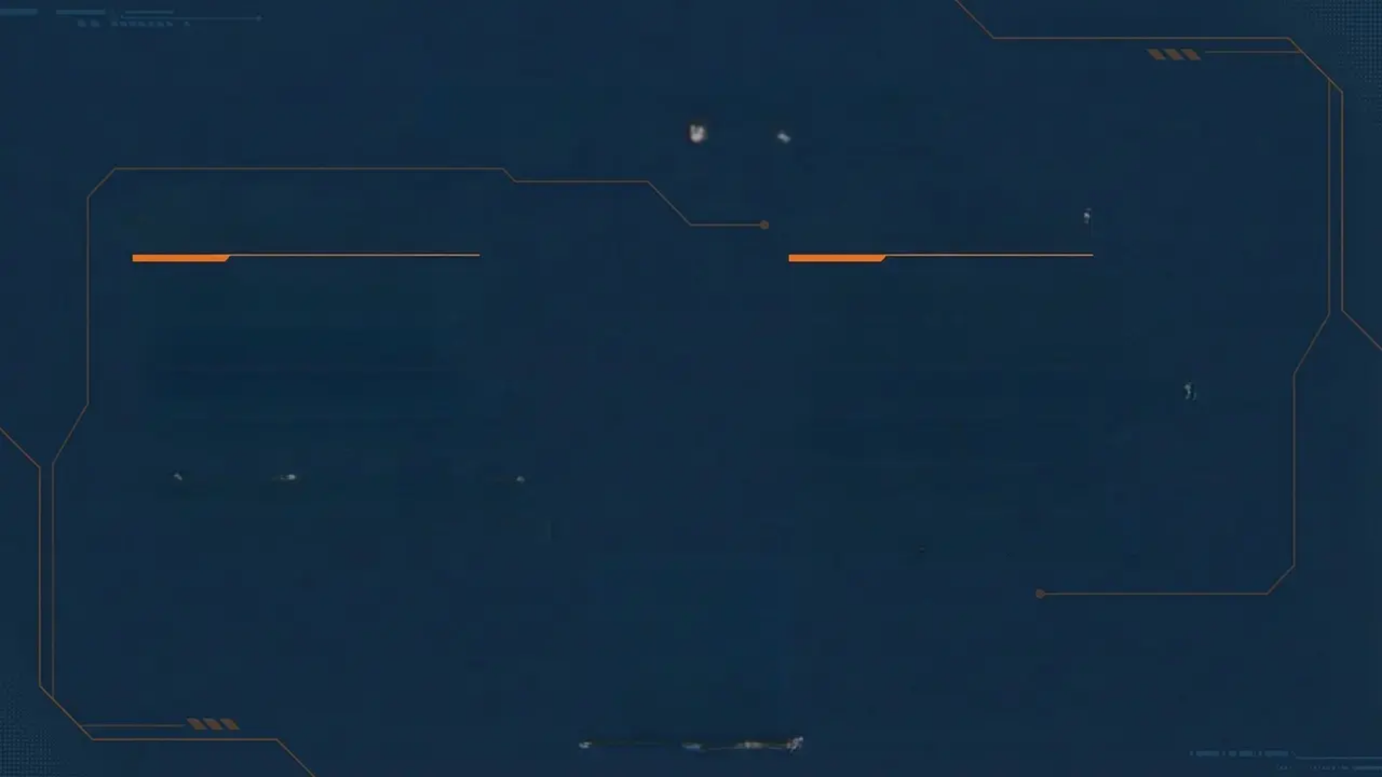
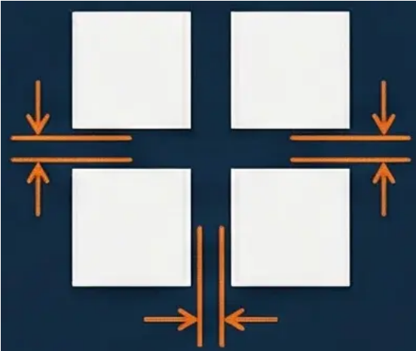
Rendering Pipeline
SDL2 Render Steps
Grid Layout Math
• Clear screen (dark grey) • Render score at top • Draw 16 tile rectangles • Render tile number text • Present frame to display • Game over overlay (alpha)
• Window: 900×800 pixels • Grid: 600px centered • Left offset: 150px margin • Tiles: 137px squares • Gaps: 10px spacing • Grid top: 120px down
2×2 Grid Tile Layout Concept

Slide 9
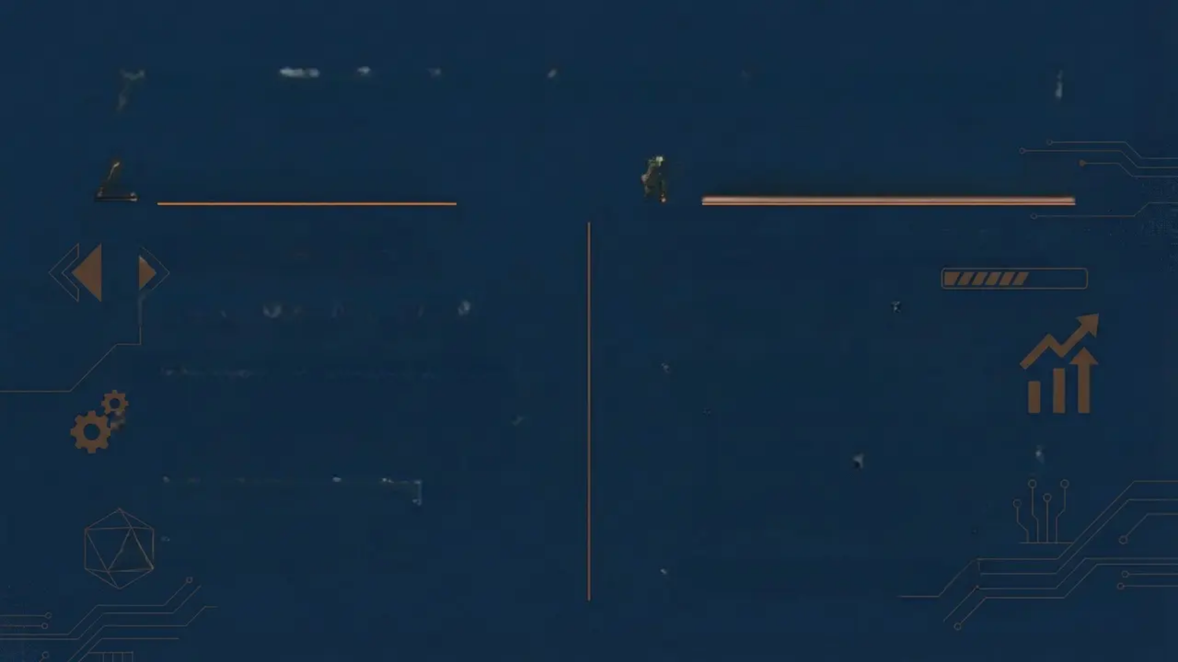


Known Limitations & Future Improvements
Current Limitations
Proposed Improvements
Score sums all tiles
Persistent score with file I/O
No high score persistence
Restart on R key
No restart mechanic available
Smooth tile animations (SDL_GetTicks)
Hardcoded Windows font path
Correct merge-time scoring
No frame rate limiting
60 FPS cap (SDL_Delay)
Single merge per scan
Win detection for 2048

Slide 10
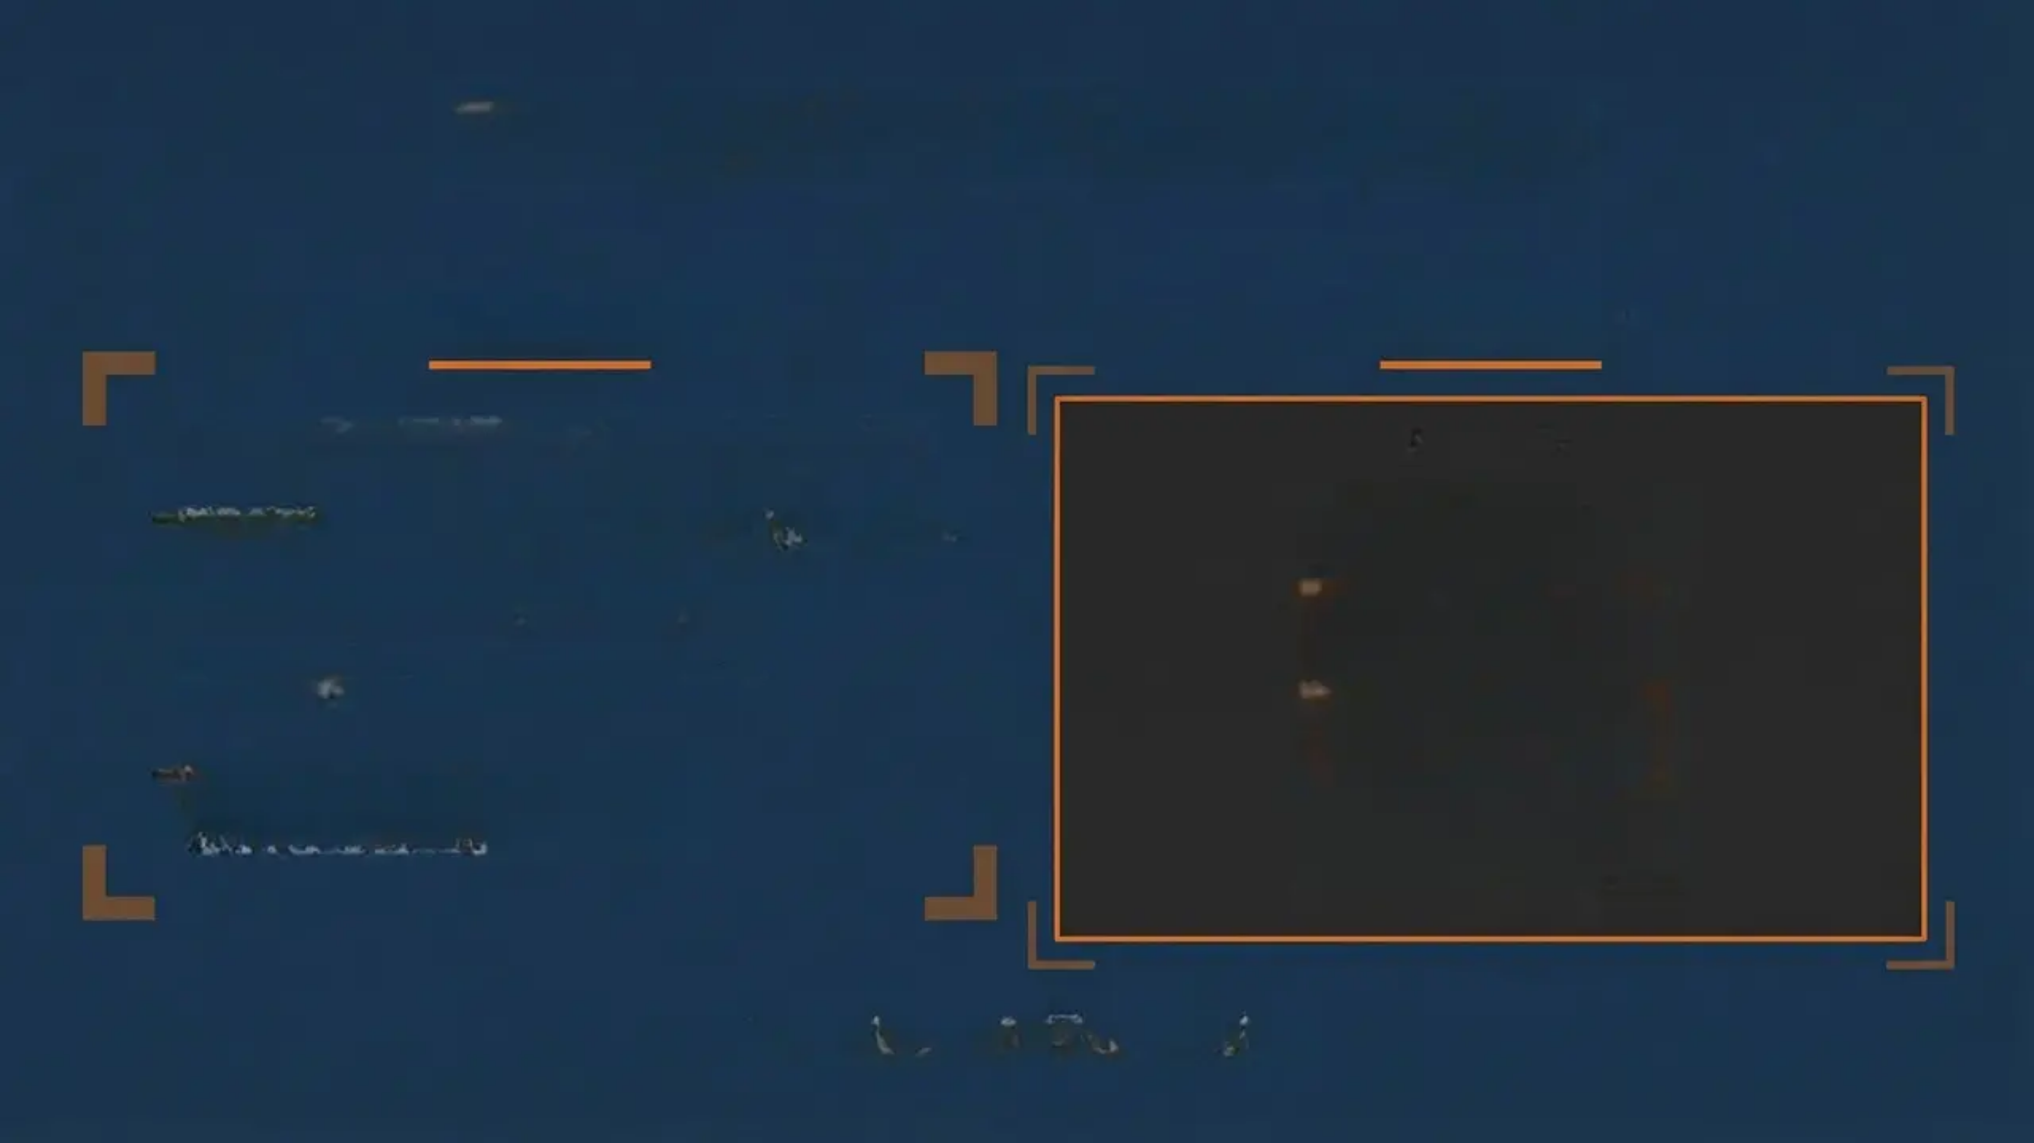
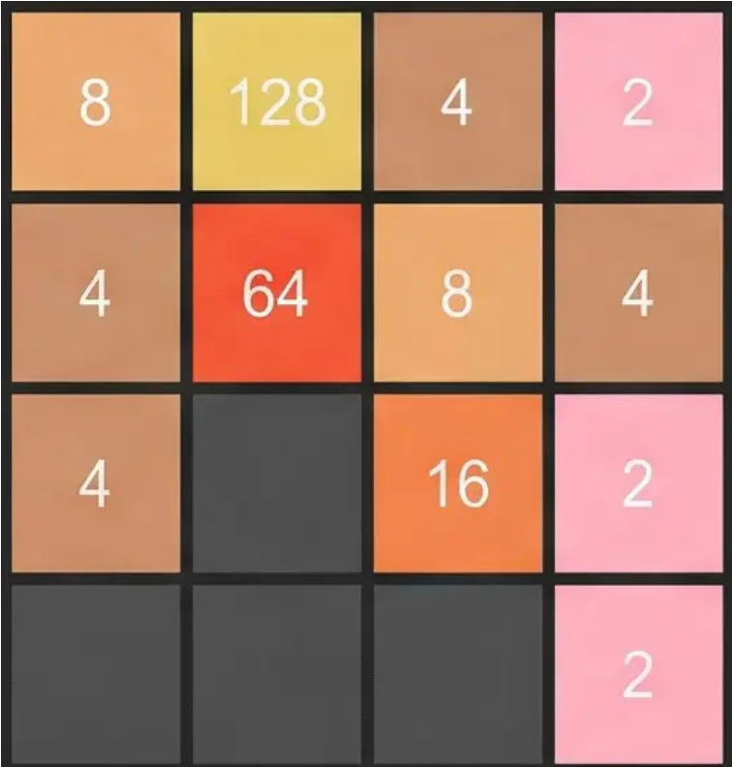
Thank You / Demo Slide
Project Summary
Live Demo
• Complete 2048 implementation in C
Score: 246
• SDL2 hardware-accelerated graphics
• Robust game logic & algorithms
• Cross-platform compatibility
• Comprehensive technical documentation
Questions & Discussion

